Slide 1


Scaling of time-series Classification in Big Data
By: Claudio Lourido
XiaoYu Yao
Ziyao Guo
Daniel de Abreu
Notes:
Begin with a brief introduction of ourselves
Introduce the paper title and a very short summary of what it is about

Slide 2
Motivation and Objectives
Growing need for scalable methods to handle large-scale time series datasets efficiently
Explore scalability of K-Nearest Neighbours and Support Vectore Machines (SVM) with Dynamic Time Warping (DTW)
Investigate the use of PySpark for parallelization to optimize processing of large time-series datasets
Benchmark our findings to scalable methods
Notes:
- Address scalability of traditional classification methods (KNN, SVM) with DTW
- Explore PySpark for distributed computing
Benchmark with Random Forest for scalability
- Emphasize the importance of scalability in time series classification for real-world applications. Huge amounts of time stamped data that grows rapidly
- Highlight the need for efficient methods to handle large and complex time series datasets.
Establish objectives to evaluate scalability and performance of traditional methods within Big Data itself
Our analysis involves observing experiments to measure the performance, scalability, and computational overhead of each approach. We discuss the practical advantages and limitations of these methods and suggest avenues for further improvement.d

Slide 3
Methodology Overview
Model Implementation
Implemented both K-Nearest Neighbors and Supper Vector Machines with Dynamic Time Warping (DTW)
Calculated DTW distances within the Spark environment
Used Random Forest with Spark as a benchmark
Loading & Preprocessing
Utilised PySpark for data handling
Extracted numeric values; handled errors with NaNs
Forward-filled missing values for data completeness
Skipped comment lines in data
Merged text and ARFF datasets, removing duplicates too
Evaluation
Compared the custom KNN with DTW to the baseline KNN
Assessed using precision, recall, F1-score, and balanced accuracy
Tested with various k parameters

Slide 4
K-Nearest Neighbours (KNN) with DTW
Calculate DTW Distances
Rank Distances
Select k Nearest Neighbours
Retrieve neighbours targets
Aggregate neighbour targets
Predict Majority Class
Notes:
- Mention the benefits of DTW for handling variable-length time series

Slide 5
Support Vector Machines (SVM) with DTW
Support Vector Machines (SVM)
Powerful, supervised learning, classification, regression
Image recognition, text categorization, bioinformatics
Dynamic Time Warping (DTW)
Time series similarity, non-linear time variation
Aligns sequences, optimal matching path
Combining SVM and DTW
Problem:Ineffective Euclidean distance, irregular time variations
Solution:DTW distance metric, better similarity assessment
Application Cases
Handwritten Digit Recognition
Speech Recognition

Slide 6
Key Differences Between KNN with DTW and SVM with DTW
Computational Complexity
KNN: High computational complexity, as each prediction requires calculating distances to all training samples.
SVM: More efficient during prediction, as it only needs to calculate the distance to the hyperplane after model training.
Model Complexity
KNN: Decision boundaries depend on the distribution of neighbors, which may perform poorly with complex data.
SVM: Can handle complex decision boundaries and non-linear problems through kernel functions.
Suitable Scenarios
KNN with DTW: Suitable for smaller datasets.
SVM with DTW: Suitable for handling complex, high-dimensional time series data.

Slide 7
Random Forest
Introduction
Random Forest is an ensemble learning method primarily used for classification and regression tasks.
It consists of multiple decision trees, and the model output is the average (regression) or the majority vote (classification) of the outputs of each tree.
Working Principle
Decision Tree: The basic building unit.
Bootstrap Aggregating (Bagging): By randomly sampling the dataset with replacement, multiple training subsets are generated.
Feature Selection: Each tree selects a random subset of features at each node split.
Voting Mechanism: In classification tasks, the prediction results of each tree are voted, and the class with the most votes is the final prediction; in regression tasks, the average of the predictions of each tree is calculated.

Slide 8
PySpark Integration
Spark MLlib、Apache Mahout、H2O.ai、TensorFlow、PyTorch、Apache Flink、Dask、Apache Giraph
Types of User-Defined Functions (UDF) in PySpark
Pandas UDF (SCALAR) : element-by-element operation.
Pandas UDF (GROUPED_MAP) : Perform operations on each group.
Pandas UDF (GROUPED_AGG) : Pandas UDF is used to aggregate grouped data.

Slide 9
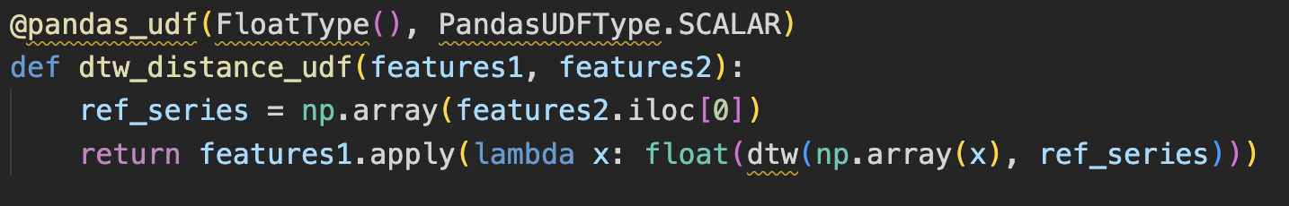
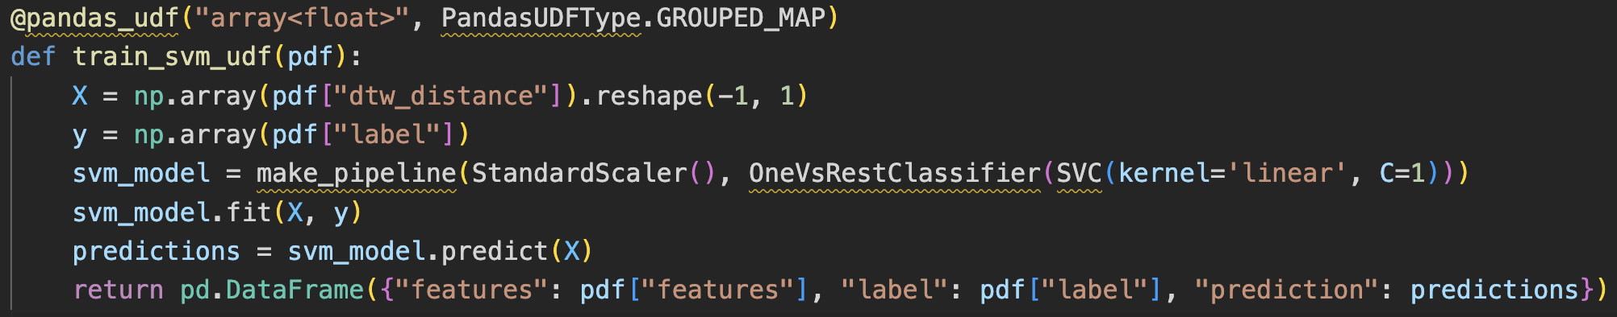
PySpark Integration

Slide 10
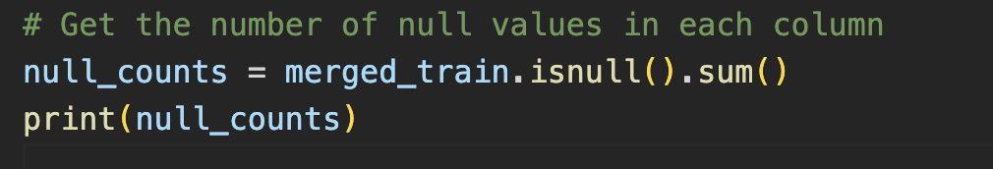
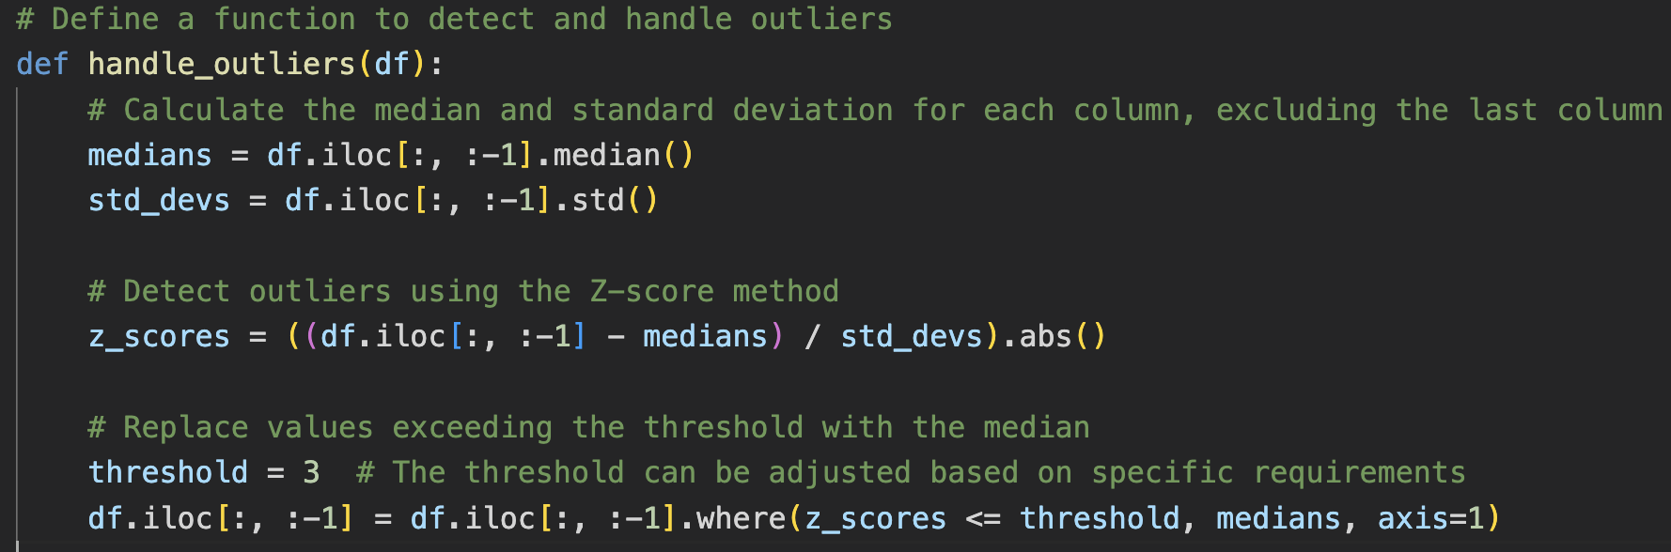
Experiments Conducted

Slide 11
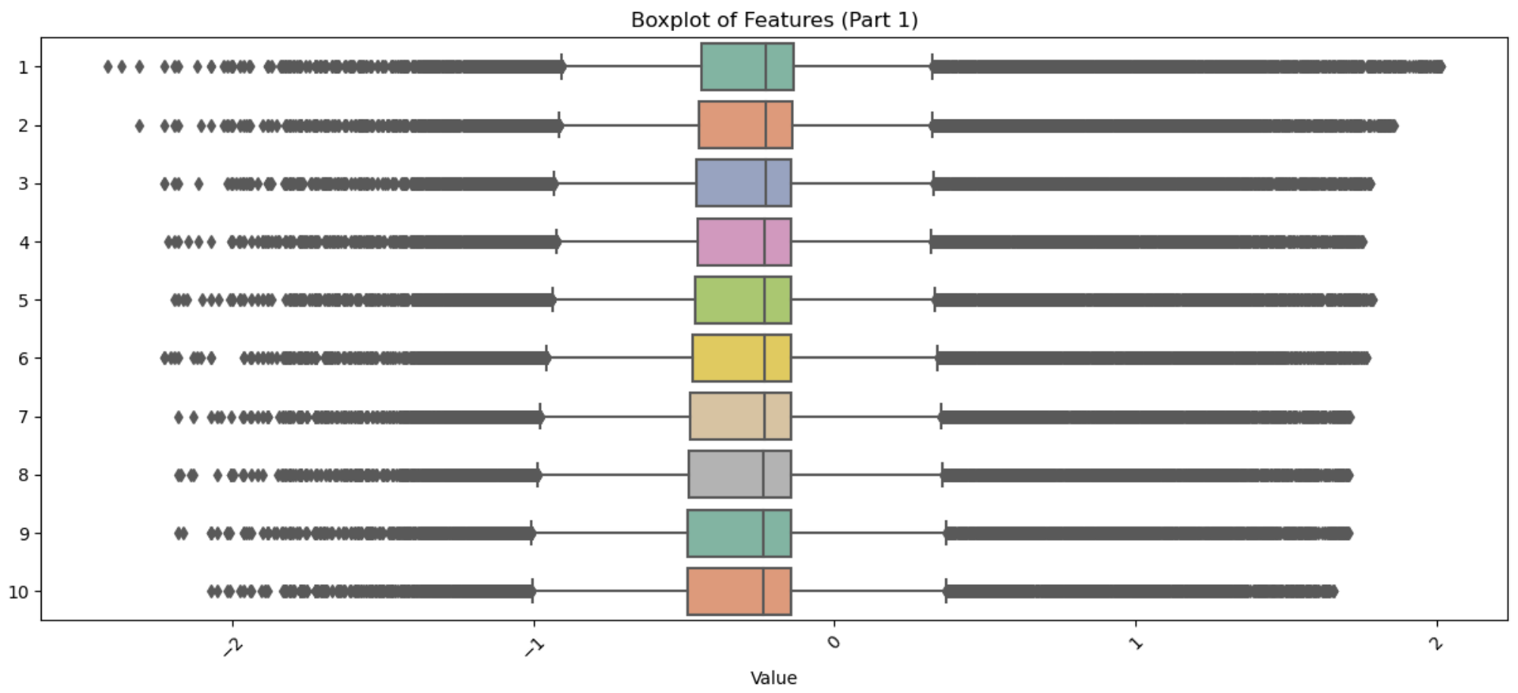
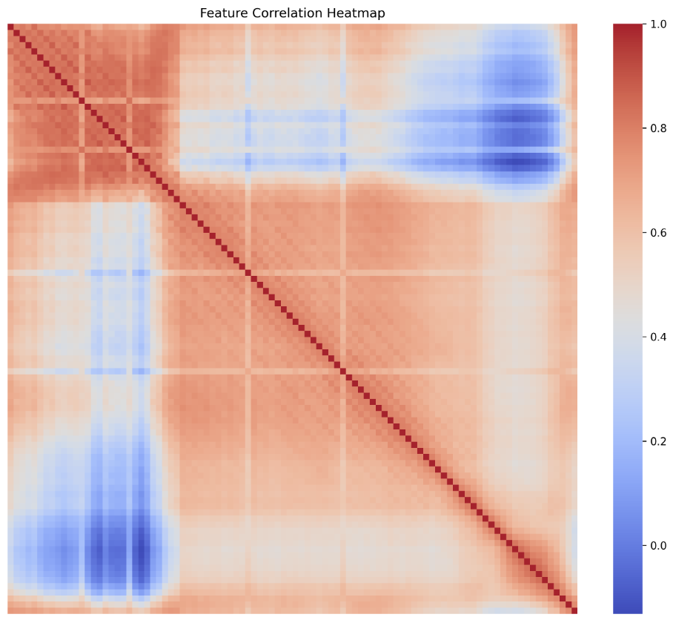
Experiments Conducted

Slide 12
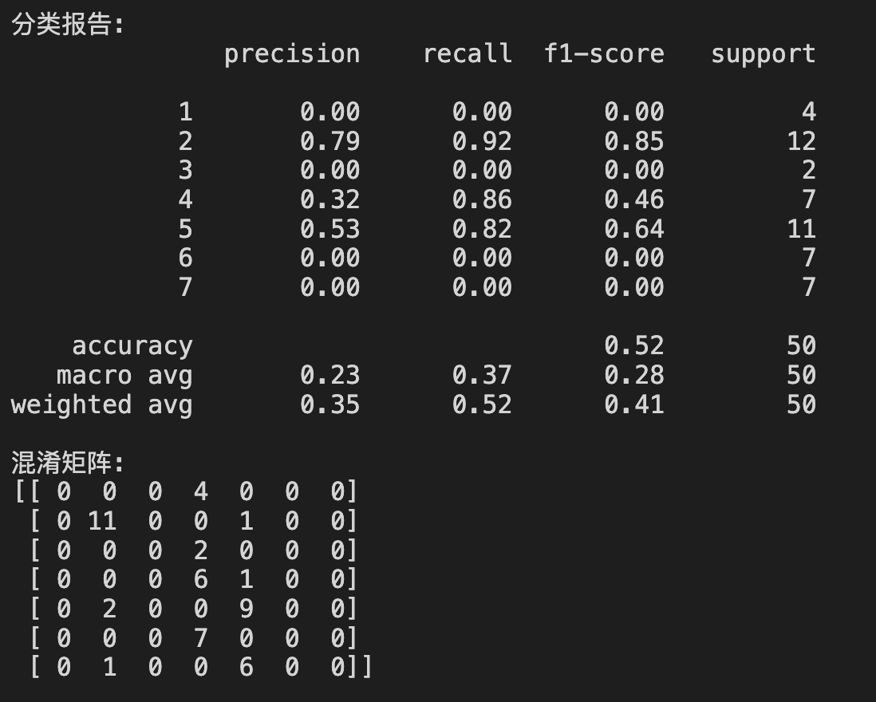
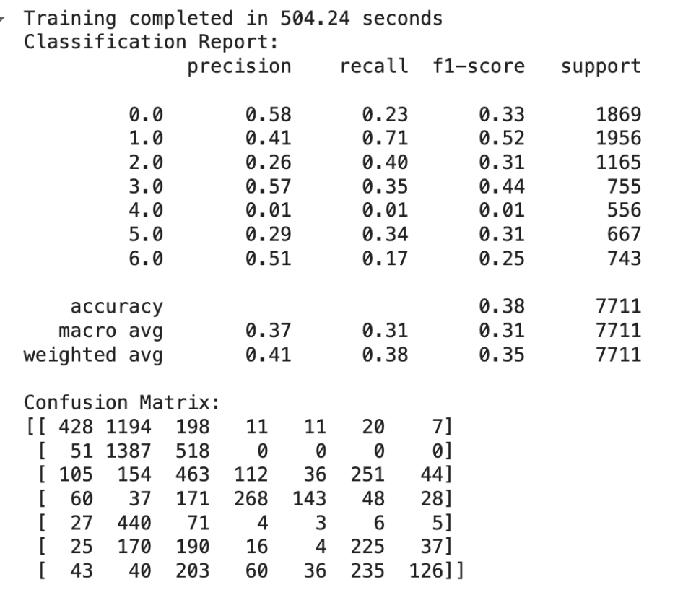
Results: Scalability Evaluation

Slide 13
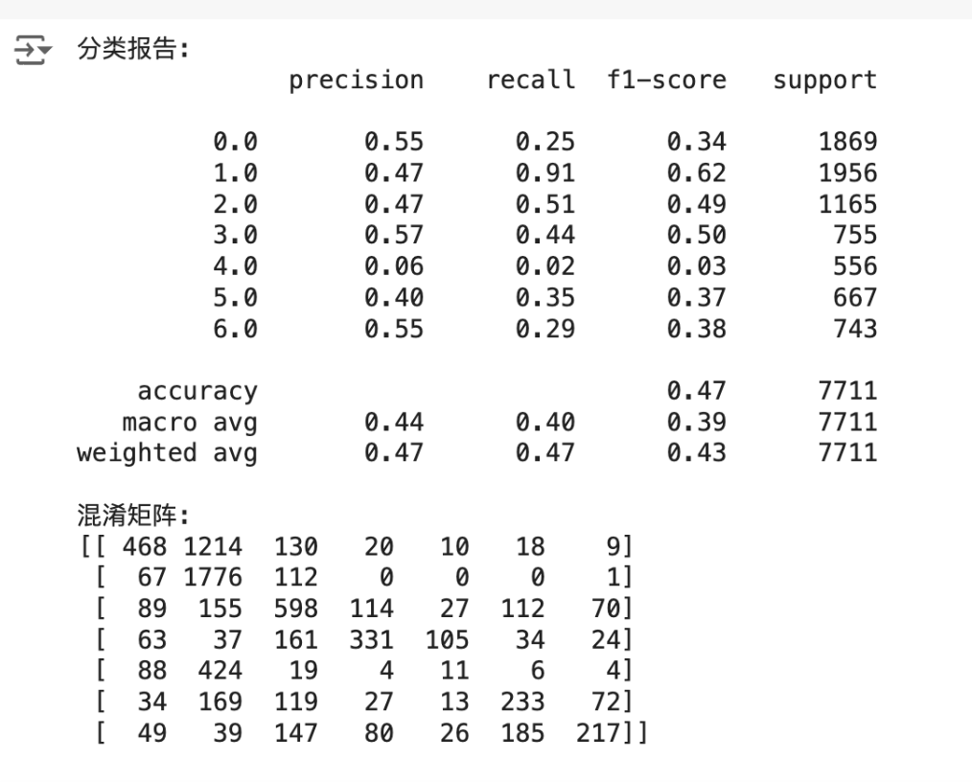
Results: Scalability Evaluation

Slide 14
Results: Performance Metrics
Performance Evaluation Metrics Used:
Precision
Recall
F1-Score
Balanced Accuracy
Analysis of model performance with varying dataset sizes
Confusion matrices reveal several misclassifications
Consistent classification scores across different K Values (KNN)
Notes:
- Emphasise the challenge in capturing the distinct patterns accurately from our time series data

Slide 15
Key Insights and Challenges
Comparison of traditional methods (KNN, SVM) with Random Forest
Accuracy scores were sub-optimal, however, scalable

Slide 16
Future Work
Locality Sensitive Hashing with KNN
Exploration of new breakthrough models such as N-BEATS
Extend research to diverse domains beyond electricity consumption
Notes:
Emphasize how we’re trying these for enhanced scalability and efficiency more than anything
The use of Locality Sensitive Hashing (LSH) with KNN to expedite nearest neighbour searches and mitigate scalability challenges

Slide 17
Questions & Answers

